Slide 1

Glyphs
CAP 5738 Data Visualization
Spring 2018
Dr. Sayeed S. Alam

Slide 2
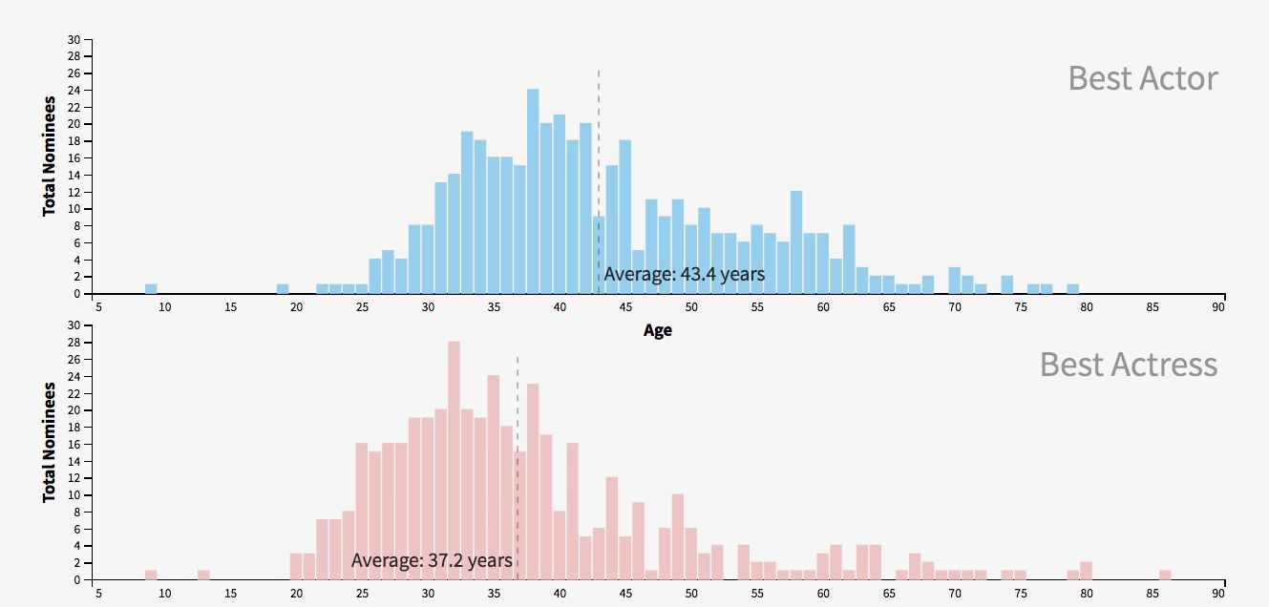
Today’s Visualization
Source: https://i.redd.it/fho1e6platj01.png

Slide 3
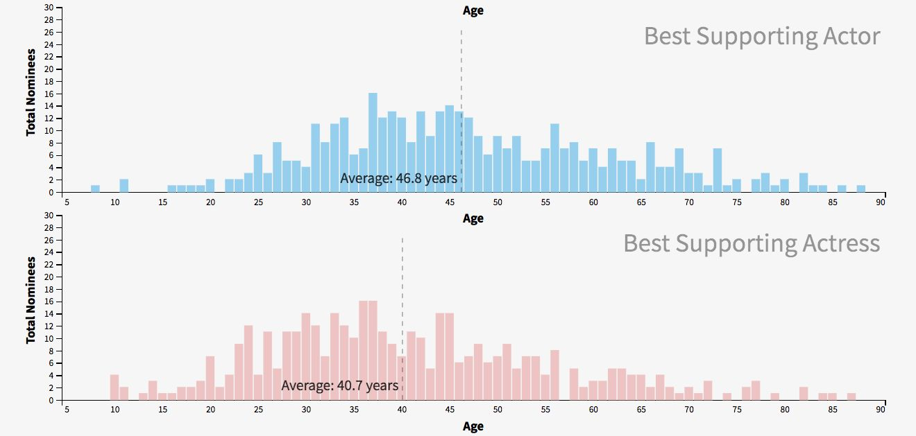
Today’s Visualization
Source: https://i.redd.it/fho1e6platj01.png

Slide 4
Glyph Based Visualization
Glyph-based visualization is a common form of visual design where a data set is depicted by a collection of visual objects referred to as glyphs.
A glyph is a small visual object that can be used independently and constructively to depict attributes of a data record or the composition of a set of data records.
Each glyph can be placed independently from others, while in some cases, glyphs can be spatially connected to convey the topological relationships between data records or geometric continuity of the underlying data space.
Glyphs are a type of visual sign that can make use of visual features of other types of signs such as icons, indices and symbols.

Slide 5
Glyphs
The term glyph is originated from Greek word, glyphe, meaning carving.
The design of glyphs can make use of many different visual channels such as shape, color, texture, size, orientation, aspect ratio or curvature, enabling the depiction of multi-dimensional data attributes.
Meanwhile, glyphs are normally recognizable individually, offering a means of visual fusion in multi-field visualization

Slide 6
Visual Signs
Signs in terms of indices, icons and symbols are all different aspects of a similar unit of knowledge representation, which has been used as a fundamental concept in trade, commerce and industry from early days to present.

Slide 7
Coding
Coding is one of the fundamental concepts in semiotics and represents a deterministic functional relation between two sets of entities, namely:
a signifier
a signified.
Reading an image, like the reception of any other message, is dependent on prior knowledge of possibilities (signifier);
we can only recognise what we know (signified).

Slide 8
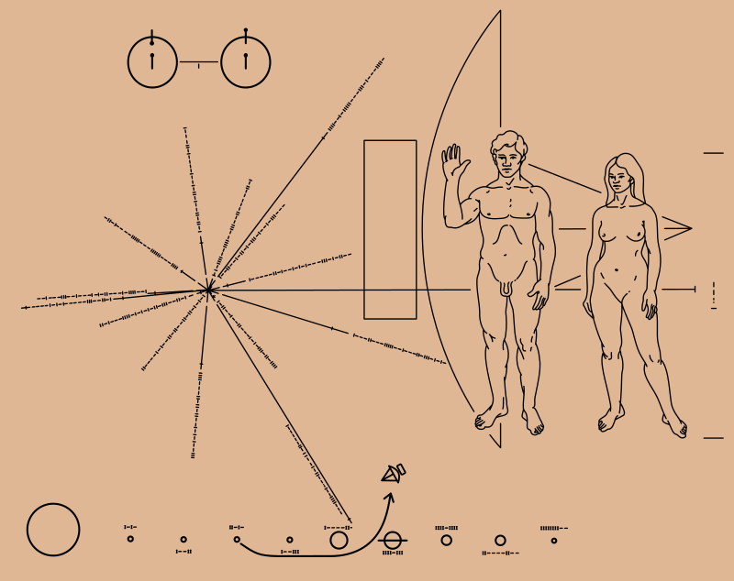
Sign/Code
Pioneer Plaque

Slide 9
Signs – Icon, Index, and Symbol
A sign in itself is a stimulus pattern associated with a meaning.
The icon, index and symbol triad represents the different relationship between the sign and its object.
Icons (such as pictures, images, models, or diagrams) represent a sign that itself resembles the qualities of the object it stands for (physical correlation).
Indexes are defined by some sensory feature (such as a clock, thermometer, fuel gauge, or medical symptom) and therefore represent a sign which demonstrates the influence of its object (space and time correlation).
Symbols (such as a trophy, medal, receipt, diploma, monument, word, phrase, or sentence) represent a sign which is interpreted as a reference to its object.
For this reason, symbols are the only type of sign which do not require any physical, space or time correlation between the sign and its meaning (metaphysical correlation).

Slide 10
Models of Signs
In modern semiotics there are two principal models of signs:
The dyadic model due to Ferdinand de Saussure and
The triadic model due to Charles Peirce [PB55]

Slide 11
Dyadic Model
In the Dyadic Model (Figure 3) introduced by Ferdinand de Saussure [SBSR83] a sign is composed of the signifier (the sound pattern of a word, either in mental projection - as when we silently recite lines from a poem to ourselves - or in actual, physical realization as part of a speech act), and the signified (the concept or meaning of the word).

Slide 12
Triadic Model
With its Triadic Model, Peirce viewed the symbol/index/icon triad as “the most fundamental division of signs”, and the majority of semioticians continue to agree.
Peirce thus defines “semiosis” as the process by which representations of objects function as signs.
Semiosis is a process of cooperation between signs, their objects, and their “interpretants” (i.e. their mental representations).
“Semiotic” (i.e. the science of signs) is the study of semiosis and is an inquiry into the conditions which are necessary in order for representations of objects to function as signs.

Slide 13
Triadic Model

Slide 14
Visual Variables
Bertin identified six visual primitives, or fundamental visual variables, which are at the basis of the construction of any graphics sign:
size,
colour hue,
colour value,
grain,
orientation,
and shape.
MacEachren proposed adding three extra variables based on advances in graphics technology:
clarity (fuzziness) of sign vehicle components,
resolution (of boundaries and images), and
transparency.

Slide 15
Visual Variables

Slide 16
Gestalt Principle
Gestalt psychologists outlined several fundamental and universal principles (or laws) of perceptual organisation which are assumed as a basis of a perceptual code:
proximity,
similarity,
continuity,
closure,
figure/ground,
area symmetry and
prägnanz.

Slide 17
Gestalt Principle: Proximity
The proximity principle states that objects that are closer to one another are perceived to be more related than those that are spaced farther apart. The proximity relation has been proved to be stronger than color similarity.

Slide 18
Gestalt Principle: Similarity
The similarity principle states that objects that are similar are perceived to be more related than those that are dissimilar.

Slide 19
Gestalt Principle: Continuity
The continuity principle states that elements that are arranged on a line or curve are perceived to be more related than elements not on the line or curve. Continuation is stronger than similarity of color.

Slide 20
Gestalt Principle: Closure
The closure principle states that elements in a complex arrangement tend to be grouped into a single, recognizable pattern.

Slide 21
Gestalt Principle: Symmetry
The symmetry principle states that objects are perceived as symmetrical shapes that form around their center. In Figure (i) the perceived picture is usually three sets of opening and closing brackets while in Figure 6e (ii) the dominant picture would be two overlapping diamonds. In the first case symmetrical balance is stronger than proximity while in the second case symmetrical regions tend to be seen as the dominant figures.

Slide 22
Gestalt Principle: Figure/Ground
The figure/ground principle (Figure 6f) states that elements
are perceived as either figure (element of focus) or ground (background or surrounding area). In this principle several factors play an important role: surrounded-ness, size (or area), symmetry, parallelism, and extremal edges. Each of these five properties can determine which parts of a figure are classified as figure or as background.

Slide 23
Gestalt Principle: Prägnanz
The prägnanz principle (Figure 6g) states that confronted with an ambiguous or complex representation the simplest and most stable interpretation is always favored.

Slide 24
Visual Channels
A visual channel is a collection of primitive visual representations that are used to convey different values of a variable.
Perceptual studies have been carried out to evaluate the effectiveness of some basic visual channels, resulting in a common consensus about pop-out effects of some of them :
colour < size <shape <orientation

Slide 25
Visual Channels

Slide 26
Glyph Design Criteria
A glyph is composed by a set of visual channels, each of which encodes a variable of a multivariate data record.
Naturally the first criterion is that the visual channel should ideally be able to encode many valid values of that variable, or collectively, different visual channels of the glyph could encode many data records with different combinations of data values.

Slide 27
Glyph Design Criteria
Eight criteria for glyph design in the context of sorting glyphs visually:
Typedness
Visual Orderability
Channel Capacity
Separability
Searchability
Learnability
Attention Balance
Focus and Context

Slide 28
Glyph Design Criteria

Slide 29
Glyph Design Criteria
Typedness – This criterion refers to whether or not each visual channel in a glyph is appropriately selected to match with the data type of the variable to be encoded. Such data types may include, but not limited to: nominal, ordinal, interval, ratio, and directional.
Visual Orderability – When a variable to be encoded is orderable, the corresponding visual channel should ideally be orderable visually (e.g., size, greyscale intensity, but not an arbitrary set of shapes).
Channel Capacity – This refers to the number of values that may be encoded by a visual channel. Such a number is often affected by the size of a glyph and many perceptual factors (e.g., just-noticeable-difference, interference from nearby visual objects).
Separability – When two or more visual channels are integrated into a compound channel, such as combining intensity, hue and saturation into a colour channel, the interference between different primitive channels should be minimised.

Slide 30
Glyph Design Criteria
Searchability – This refers to the levels of ease when one needs to identify a specific visual channel within a glyph for a specific variable.
Learnability – This is often an important criterion in many applications. Ideally, a glyph design should be easy to learn, and easy to remember. There are many factors that may affect a visual design in this context, for instance, whether there are well-defined constructive rules, whether there are memorable metaphors, whether it is easy to guess, and so on.
Attention Balance – Different visual channels in a glyph will receive different levels of attention. Ideally, the levels of attention should correspond to the levels of importance of the variables. However, this is easier said than done as the relative importance of a variable is often undefined or may vary from tasks to tasks
Focus and Context – This refers to the need to identify an individual visual channel under a certain interactive operation. For example, when a user select a certain variable as a sort key, it is desirable to highlight the corresponding visual channel so it stands out from other channels.

Slide 31
Data Mapping
Each dimension or variable of a data set will map to a specific graphical attribute.
An important issue in using glyphs is to ascertain which ordering(s) will be most supportive of the task at hand.
Several possibilities exist, beyond random ordering or the order in which the variables were originally stored.

Slide 32
Correlation-driven Mapping
Correlation-driven. Many researchers have proposed using correlation and other similarity measures to order dimensions for improved visualization.
These orderings help reveal clusters of similar variables, outlier records, and gradual shifts in relationships between variables.

Slide 33
Complexity and Symmetry-driven Mapping
Gestalt principles indicate we have a preference for simple shapes, and we are good at seeing and remembering symmetry.
The shapes of star glyphs resulting from using different dimension orders were evaluated for two attributes: monotonicity (the direction of change is constant) and symmetry (similar ray lengths on opposite sides of the glyph).
The ordering that maximized the number of simple and symmetric shapes was chosen as the best. User studies showed improved performance.

Slide 34
Data-driven Mapping
Another option is to base the order of the dimensions on the values of a single record (base), using an ascending or descending sort of the values to specify the global dimension order.
This can allow users to see similarities and differences between the base record and all other records.
For example, sorting the exchange rates of 10 countries with the U.S. by their relative values in the first year of the time series exposes a number of interesting trends, anomalies, and periods of relative stability and instability.

Slide 35
Data-driven Mapping

Slide 36
Glyph Mapping
Glyph Mapping/ Instantiation
Shape Design
Appearance
Placement
Glyph Rendering
Glyph Interaction

Slide 37
Applications
Medical Visualization
Event Visualization
Multi-field Visualization
Geo-spatial Visualization
Flow Visualization
Tensor Visualization

Slide 38
References
Borgo, Rita, et al. "Glyph-based Visualization: Foundations, Design Guidelines, Techniques and Applications." Eurographics (STARs). 2013.

Slide 39
Thank You

